Slide 1




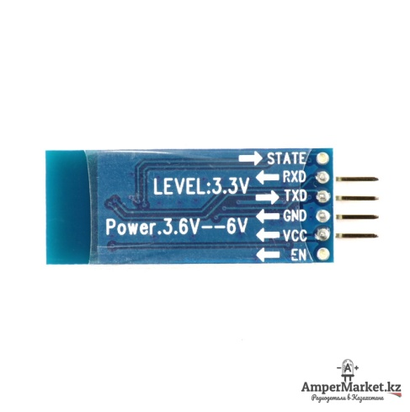


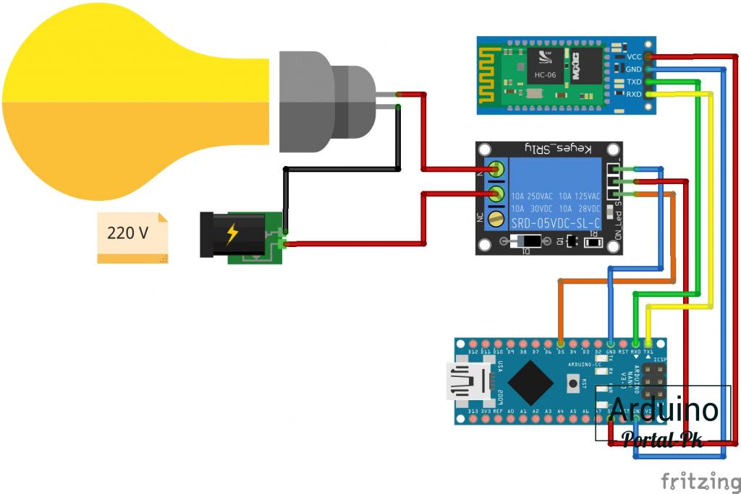
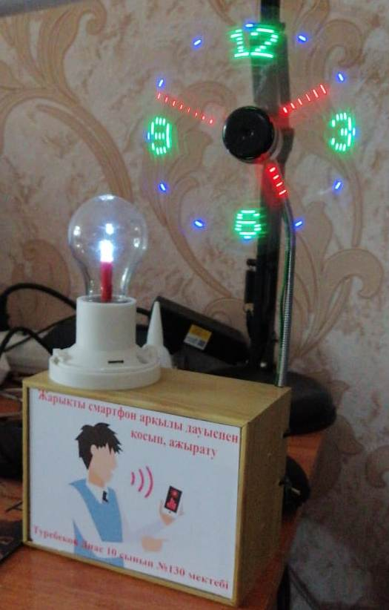
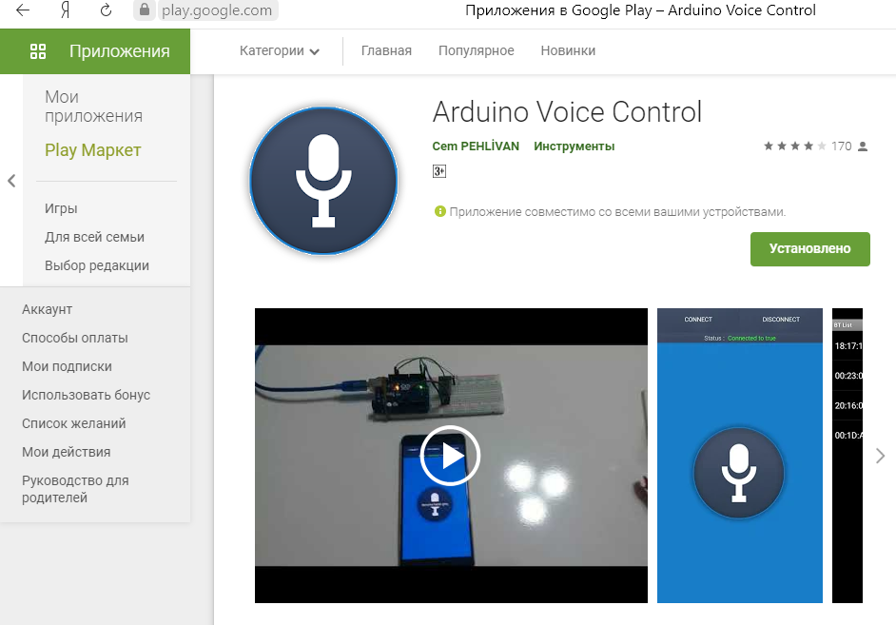
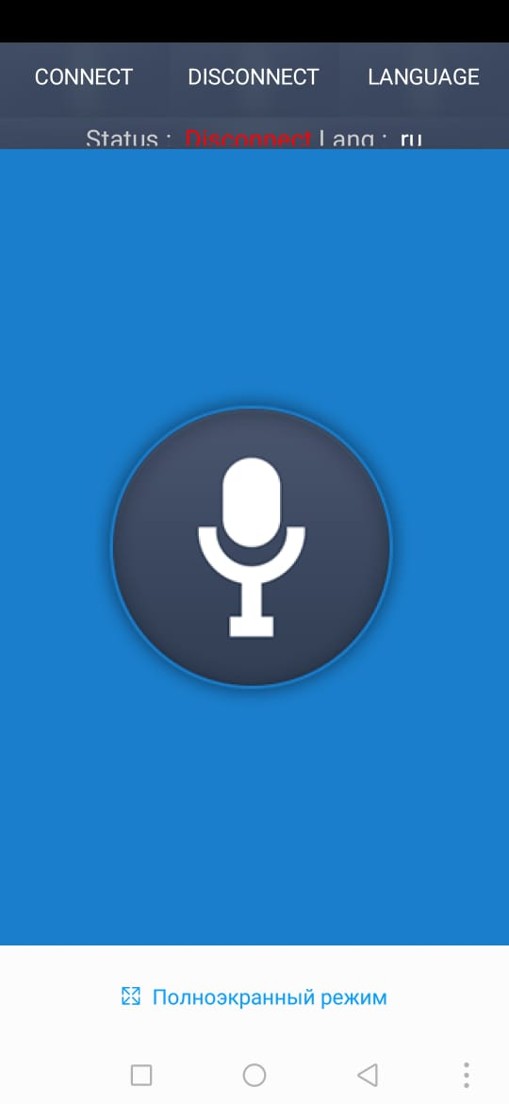








Lamp control with smartphone
Asel Aykozy
M. Auezov South Kazakhstan university
www.icse.eu/international-projects/most
Lamp control with smartphone.
Aims of project work: Define the ways to turn on the light and fan by voice using a smartphone, saves time and gives a comfortable mood.
0
Necessary tools and materials
  We control the light and fan by voice using a smartphone. Here we will use arduino parts and create a series of programs. If we take the fan here, it works with 5 volts of power.
  Fan
  Arduino microcontroller
  Power bank
  Bluetooth module of HC-06 device
  Lamp
  Mobile App
An arduino microcontroller is installed, our bluetooth module HC-06 is connected to it,
  We control the light and fan by voice using a smartphone. When we say “turn on the fan” with our voice, the fan is spinning. And if you say to your smartphone “turn off the fan” with your voice, the fan will stop rotating. There is a built-in light bulb, to turn on this lamp we say the word "light" to the smartphone with our voice, then the light will turn on, if we say "turn off the light" the light will turn off by itself.

